Slide 1
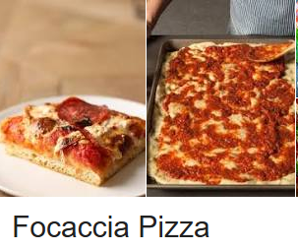
Momma’s focaccia ristorante
A place for families and friends
(and the occasional Angel investor)

Slide 2
What is our goal?
I want to create a tool that can help me open a franchise of restaurants serving niche, ethnic communities usually located in just one city neighborhood. I would like to show a group of investors why this location and this cuisine makes sense. I first need to make a go/no-go decision based on crime rates in the area. I only want to open a restaurant in a low-crime area. If the crime rate is low, I want to pick a cuisine that is underserved in that community (using Foursquare data). This capstone project will test this tool in Toronto and apply it to the Squirrel Hill neighborhood of Pittsburgh, Pennsyvania, USA.

Slide 3
How do we find out?
Map the areas of interest, both Toronto and Pittsburgh.
Scrape the above website for Pittsburgh crime data.
make a go/no-go decision based on crime
Toronto. This work becomes the training data for Pittsburgh
Pull in Toronto neighborhood data from Wikipedia
Pull in the Foursquare venue data for those neighborhoods
Cluster the neighborhoods via KMeans clustering
Pittsburgh. One neighborhood in Pittsburgh, Squirrel Hill, is the most populated area for the the ethnic community. This is known experientially, not derived via data.
Use KNN to build a prediction model based on the Toronto data. I will classify the Squirrel Hill neighborhood based off of this data.

Slide 4
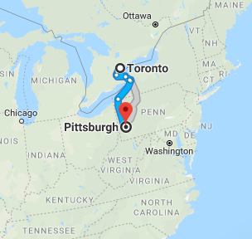
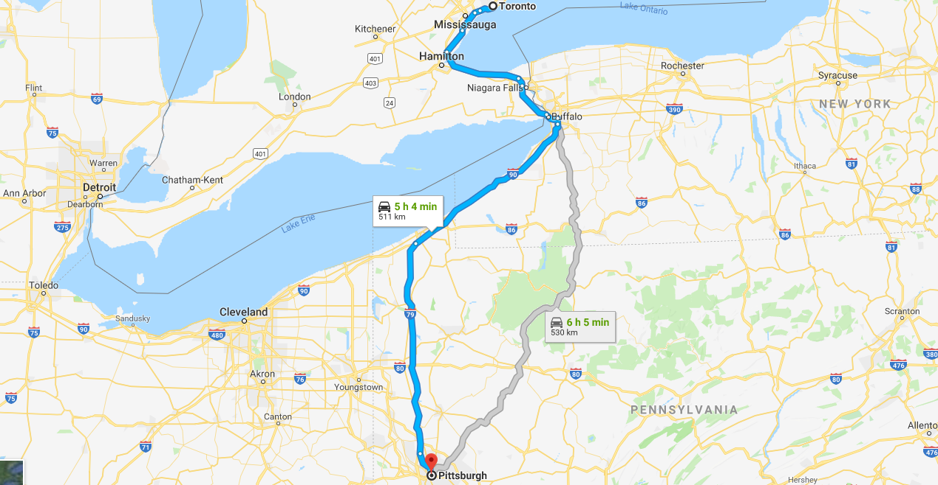
From Toronto to Pittsburgh What is the best restaurant to open?

Slide 5
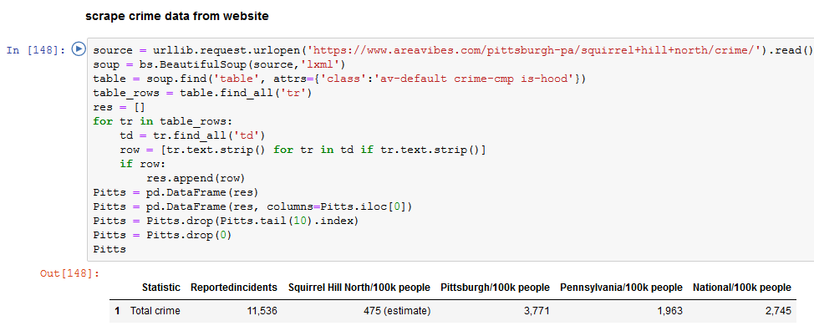
Squirrel Hill in Pittsburgh is a safe place to open a restaurant! Its crime rate is less than 15% of all Pittsburgh

Slide 6
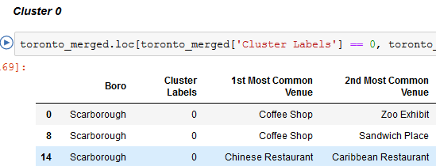
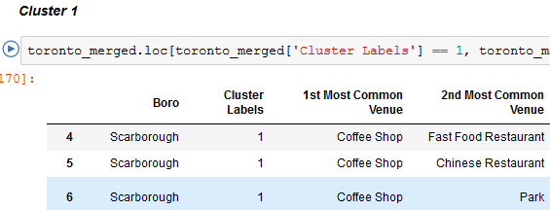
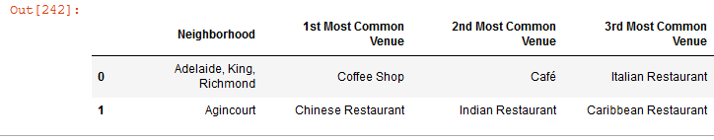
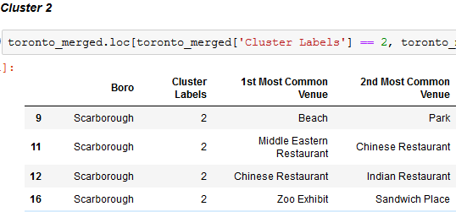
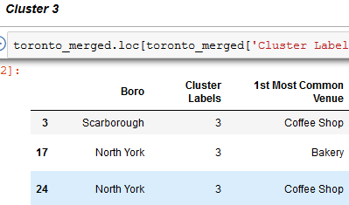
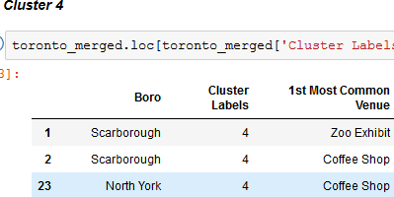
Toronto’s many neighborhoods can be clustered into 5 areas
Neighborhood examples
Transformed by KMeans

Slide 7
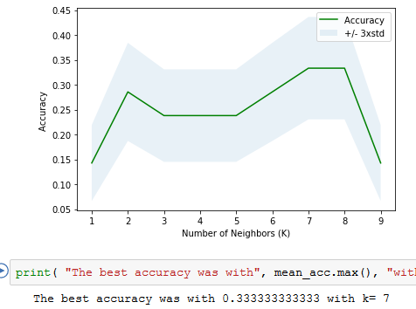
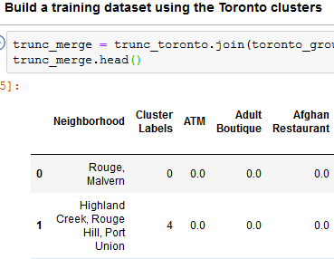
Build a prediction model for Squirrel Hill using KNN (K = 7)

Slide 8
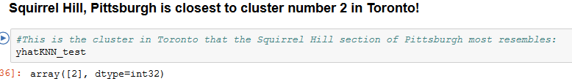
KNN Predicts Squirrel Hill to look like cluster number 2

Slide 9
The best bet based on data and intuition!
Toronto cluster number 2 is what I would call "Homey." It is predominately coffe shops and cafes, with a smattering of ethnic cuisine restaurants. There are few parks and hotels, a bit of shopping too. However, the venues appear to me to be more parochial -- not upscale and swank, not seedy or undesirable.
Squirrel Hill in Pittsburgh has this same look. It is also a very low crime area. I can say from experience, having just visited both these places over winter holiday, that they have the same quaint feel. Less-rushed, but still modern neighborhoods.
Squirrel Hill is dominated by Bakeries, Bars, and Ice Cream Shops. It has several pizza places, parks, grocery stores, and even some ethnic restaurants. Cluster 2 in Toronto has several Italian restaurants as well in the first and second most popular venues.
I believe the most successful restaurant in Squirrel Hill might be a more upscale Italian restaurant, a step up from pizza and more akin to ethnic cuisine.
I give you Momma's Focaccia Ristorante!

